Slide 1

HTML5 Fundamentals - Session 2
Course Overview: HTML5 Fundamentals
Session 2 of 2 (2 hours)
Topics:
Lists and Tables
Forms and Form Validation
HTML5 Form Features
Best Practices and Review
HTML5 Fundamentals
Session 2

Slide 2

Review of Session 1
HTML5 basics and evolution
Document structure
Semantic elements:
header, nav, main, section, article, aside, footer
Multimedia elements:
img, audio, video, figure, figcaption
HTML5 Fundamentals
Session 2

Slide 3

Introduction to Lists
Organize information in a structured format
Three main types:
Ordered lists
Unordered lists
Description lists
Can be nested for hierarchical data
HTML5 Fundamentals
Session 2

Slide 4

Ordered Lists
Used for sequential items
Created with
<ol>
and
<li>
elements
First item
Second item
Third item
HTML5 Fundamentals
Session 2

Slide 5

Ordered List Attributes
type
: Numbering style (1, A, a, I, i)
start
: Starting number
reversed
: Counts down instead of up
This will be C
This will be D
HTML5 Fundamentals
Session 2

Slide 6
Unordered Lists
Used for non-sequential items
Created with
<ul>
and
<li>
elements
Apples
Oranges
Bananas
HTML5 Fundamentals
Session 2

Slide 7

Description Lists
Used for term-definition pairs
Created with
<dl>
,
<dt>
, and
<dd>
elements
HTML
HyperText Markup Language
CSS
Cascading Style Sheets
HTML5 Fundamentals
Session 2

Slide 8

Nesting Lists
Lists can be nested inside other lists
Fruits
Apples
Oranges
Vegetables
Carrots
Broccoli
HTML5 Fundamentals
Session 2

Slide 9

Exercise 1
Task:
Create a recipe using lists
Create a new HTML file
Use an ordered list for the recipe steps
Use an unordered list for the ingredients
Use a description list for nutritional information
Include at least one nested list
HTML5 Fundamentals
Session 2

Slide 10

Introduction to Tables
Used to display tabular data
Created with
<table>
element
Rows created with
<tr>
(table row)
Cells created with
<td>
(table data)
Headers created with
<th>
(table header)
HTML5 Fundamentals
Session 2

Slide 11
Basic Table Structure
Name
Age
Country
John
25
USA
Maria
30
Spain
HTML5 Fundamentals
Session 2

Slide 12

Table Headers and Footers
<thead>
: Groups header content
<tbody>
: Groups body content
<tfoot>
: Groups footer content
Month
Sales
January
$10,000
Total
$10,000
HTML5 Fundamentals
Session 2

Slide 13

Spanning Rows and Columns
colspan
: Spans multiple columns
rowspan
: Spans multiple rows
Name
Age
First
Last
25
John
Doe
HTML5 Fundamentals
Session 2

Slide 14

Accessible Tables
Use
<caption>
for table title
Use
scope
attribute on headers
Use
<th id>
and
<td headers>
for complex tables
Monthly Savings
Month
Savings
January
$100
HTML5 Fundamentals
Session 2

Slide 15
Exercise 2
Task:
Create a class schedule table
Create a new HTML file
Create a table with days of the week as columns
Use time slots as rows
Use rowspan for classes that take multiple periods
Add a caption and proper header cells with scope
HTML5 Fundamentals
Session 2

Slide 16
Introduction to Forms
Used to collect user input
Created with
<form>
element
Contains various input elements
Submits data to a server
HTML5 Fundamentals
Session 2

Slide 17

Form Attributes
action
: URL where form data is sent
method
: HTTP method (get or post)
name
: Form name for scripting
autocomplete
: Browser autocomplete feature
novalidate
: Disables browser validation
HTML5 Fundamentals
Session 2

Slide 18

Text Input Fields
Basic text input:
Username:
Password input:
Password:
HTML5 Fundamentals
Session 2

Slide 19

Input Attributes
name
: Identifies the field when submitted
id
: Links label to input for accessibility
value
: Default value
placeholder
: Hint text
required
: Makes field mandatory
disabled
: Makes field non-editable
readonly
: Makes field read-only
HTML5 Fundamentals
Session 2

Slide 20

Radio Buttons
Used for selecting one option from many
Select your gender:
Male
Female
Other
HTML5 Fundamentals
Session 2

Slide 21

Checkboxes
Used for selecting multiple options
Select your hobbies:
Reading
Sports
Music
HTML5 Fundamentals
Session 2

Slide 22

Select Dropdowns
Used for selecting from a list of options
Country:
HTML5 Fundamentals
Session 2

Slide 23

Textarea Element
Used for multi-line text input
Message:
Default text here...
HTML5 Fundamentals
Session 2

Slide 24

Button Types
Submit button:
Reset button:
Button element:
Click Me
HTML5 Fundamentals
Session 2

Slide 25

Form Validation Attributes
required
: Field must be filled
minlength
/
maxlength
: Text length limits
min
/
max
: Number range limits
pattern
: Regular expression pattern
HTML5 Fundamentals
Session 2

Slide 26
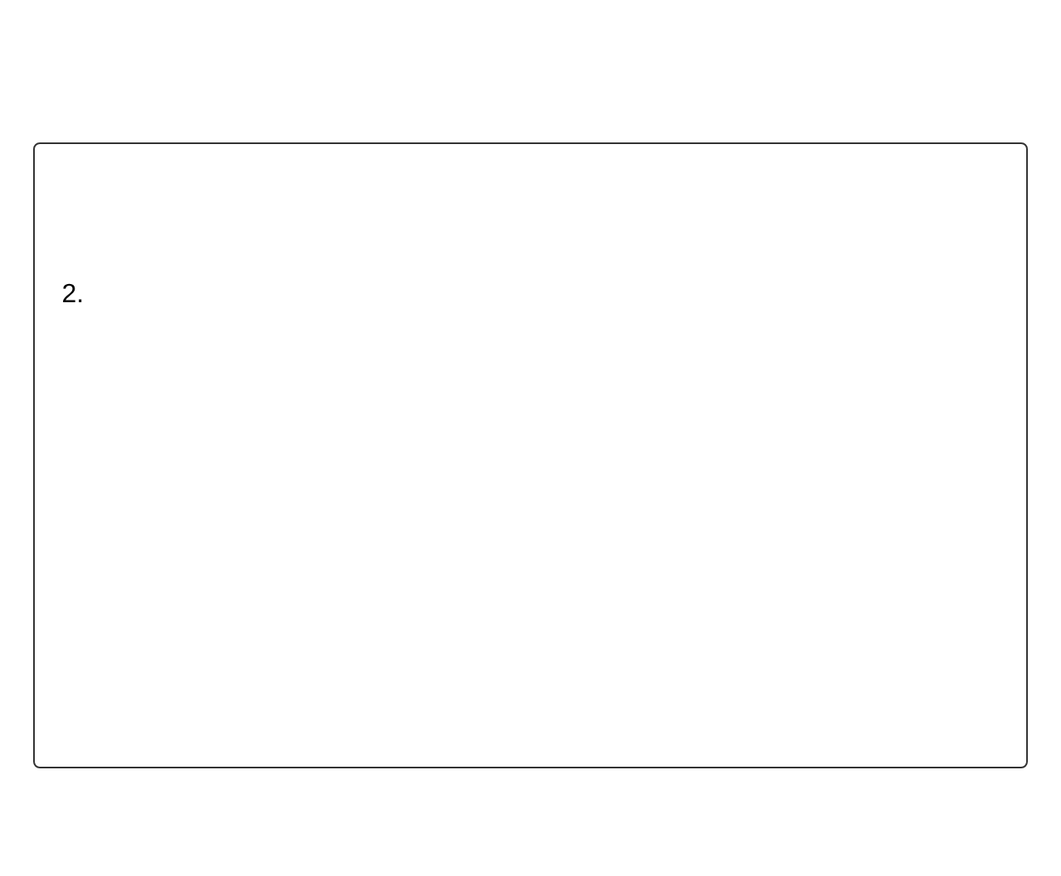
Exercise 3
Task:
Create a registration form
Create a new HTML file
Create a form with the following fields:
Name (text, required)
Email (email, required)
Password (password, required)
Gender (radio buttons)
Interests (checkboxes)
Country (select dropdown)
Bio (textarea)
Add appropriate validation attributes
Add a submit and reset button
HTML5 Fundamentals
Session 2

Slide 27

HTML5 New Input Types
Email:
<input type="email">
URL:
<input type="url">
Number:
<input type="number">
Range:
<input type="range">
Date:
<input type="date">
Color:
<input type="color">
Search:
<input type="search">
Tel:
<input type="tel">
HTML5 Fundamentals
Session 2

Slide 28
Datalist Element
Provides autocomplete suggestions for inputs
Choose your browser:
HTML5 Fundamentals
Session 2

Slide 29

Output Element
Container for results from calculations
+
=
100
HTML5 Fundamentals
Session 2

Slide 30

Progress and Meter Elements
Progress: Shows completion of a task
70%
Meter: Shows a value within a known range
60%
8 out of 10
HTML5 Fundamentals
Session 2

Slide 31

Form Validation API
HTML5 provides built-in form validation
Can be customized with JavaScript
Validation occurs before form submission
Provides user feedback for invalid inputs
HTML5 Fundamentals
Session 2

Slide 32
Exercise 4
Task:
Create an advanced form
Create a new HTML file
Create a form that uses at least 3 HTML5 input types
Include a datalist for one of the fields
Add a progress or meter element
Implement custom validation messages
HTML5 Fundamentals
Session 2

Slide 33

HTML5 Coding Standards
Use lowercase element names
Close all elements properly
Use quotes around attribute values
Indent nested elements
Use semantic elements appropriately
Validate your HTML: validator.w3.org
HTML5 Fundamentals
Session 2

Slide 34
Accessibility Considerations
Use semantic HTML elements
Provide alternative text for images
Use labels for form elements
Ensure keyboard navigation works
Use ARIA attributes when needed
Test with screen readers
HTML5 Fundamentals
Session 2

Slide 35
SEO Implications
Semantic HTML improves search engine ranking
Proper heading structure helps SEO
Descriptive title and meta tags are important
Alt text for images helps with image search
Clean, valid HTML is easier for crawlers
HTML5 Fundamentals
Session 2

Slide 36
Performance Optimization
Minimize HTTP requests
Use async and defer for scripts
Optimize images and media
Use responsive images
Minify CSS and JavaScript
Use browser caching
HTML5 Fundamentals
Session 2

Slide 37
Tools and Resources
W3C Validator: validator.w3.org
MDN Web Docs: developer.mozilla.org
Can I Use: caniuse.com
HTML5 Boilerplate: html5boilerplate.com
CodePen: codepen.io
Visual Studio Code: code.visualstudio.com
HTML5 Fundamentals
Session 2

Slide 38
Course Summary
HTML5 basics and evolution
Semantic structure elements
Multimedia elements
Lists and tables
Forms and validation
HTML5 new features
Best practices and standards
HTML5 Fundamentals
Session 2

Slide 39
Next Steps
Practice building complete HTML5 pages
Learn CSS to style your HTML
Explore JavaScript for interactivity
Build responsive websites
Join web development communities
Create a portfolio of projects
HTML5 Fundamentals
Session 2

Slide 40

Final Exercise
Task:
Create a complete HTML5 page
Create a new HTML file
Include proper document structure
Use semantic elements for layout
Add at least one multimedia element
Include a table and different types of lists
Create a form with various input types
Implement form validation
Follow accessibility best practices
HTML5 Fundamentals
Session 2

